Slide 1
Social Determinants of Health (SDOH)
Leveraging Analytics to Address Healthcare in Gambia Disparities in Gambia

Slide 2
INTRODUCTION
HealthLink empowers stakeholders to allocate resources more effectively and improve health outcomes, particularly in underserved communities. The company's interventions have been recognized for significantly reducing hospital readmission rates by addressing core issues such as housing instability and transportation challenges.

Slide 3

OBJECTIVE
Promote health equity through fair resource allocation.
Automate processes for faster, more reliable insights.
Enable data-driven interventions targeting root causes of disparities.
Enhance decision-making for policymakers and healthcare providers.
Improve community health outcomes by addressing vulnerabilities effectively.

Slide 4
Problem statement
Data Silos & Fragmentation
Manual & Inefficient Data Processing
Lack of Real-Time Insights
Geospatial Data Gaps:

Slide 5
Technology Stack
Excel
EDA and consolidate data using data provided
Power BI:
Create interactive dashboards with geospatial and trend analysis.
Map disparities and identify intervention priorities visually.
Power Service:
Automate data refreshes and workflow notifications.
Power Automate:
Use Power Automate to sync new Excel 9ihjndata with dashboards and notify stakeholders in real-time.

Slide 6
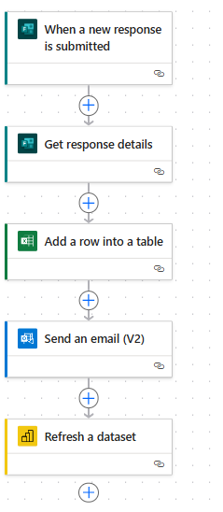
Integrate Fragmented Datasets
The splitted dataset was consolidated for analysis in Power BI under the headers listed below
Automate Data Collection and Processing
Data collection was automated to guarantee the structured data was gathered as specified above.

Slide 7
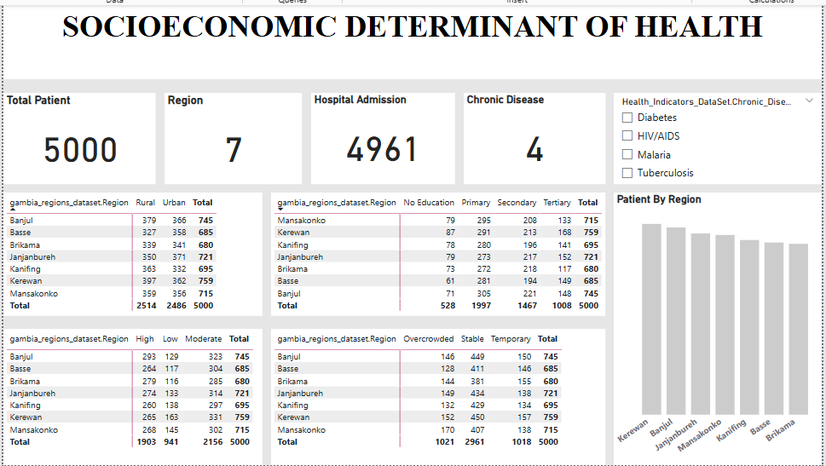
RESULT

Slide 8
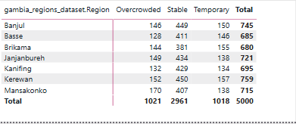
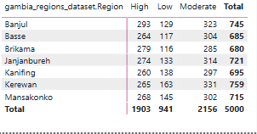
Insight and Recommendations
majority of patients have a moderate level of health literacy.
Banjul has the highest and second most moderate health literacy.
The Regions with highest numbers of individuals of moderate health literacy, might need targeted interventions to improve health education.
The Regions with highest number of individuals of high health literacy, may have better access to health information and education programs.
The number of patients in overcrowded housing is relatively high, which may contribute to health issues.
Implement policies to improve housing standards and reduce overcrowding.
Encourage community-based interventions for sanitation and clean water access.

Slide 9
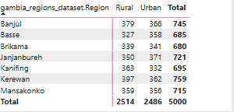
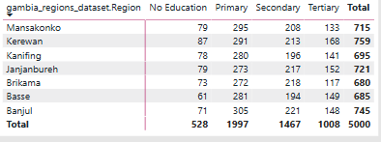
The data shows that a significant portion of patients has only Primary or Secondary education.
Patients with No Education (528 people) may have limited health awareness, leading to late diagnosis or poor disease management.
The dataset divides the patient population into rural and urban groups.
Generally, Rural communities has higher patient.
Some regions (e.g., Kerewan) have a higher number of rural patients (397) compared to urban patients (362).
Other regions, like Basse, have more urban patients (358) than rural ones (327).
Develop health education programs targeting communities with low literacy levels.
Integrate health awareness into school curriculums to encourage long-term healthy habits.
Invest in rural healthcare facilities to ensure better access to medical services.
Deploy mobile health clinics to serve remote communities.

Slide 10
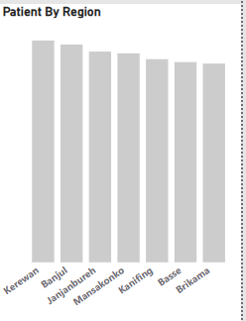
Kerewan and Banjul Regions have the highest number of patients, which may suggest higher disease prevalence, improved reporting, or other contributing factors such as population density and healthcare access.
Conduct further analysis to determine if Kerewan and Banjul have higher disease prevalence or if the numbers reflect better healthcare access and reporting systems.

Slide 11


